Slide 1
Efficacy, Safety, and Confirmation of the Recommended Phase II Dose of Ruxolitinib Plus Panobinostat in Patients With Intermediate or High-Risk Myelofibrosis
Abstract #711
Kiladjian JJ, Heidel FH, Vannucchi AM, Ribrag V, Francesco P, Hayat A, Conneally E, Martino B, Kindler T, Lipka DB, Acharyya S, Gopalakrishna P, Ide S, Loechner S, Mu S, Harrison CN
Notes:
1

Slide 2
Introduction
Myelofibrosis (MF) is a myeloproliferative neoplasm characterized by bone marrow fibrosis, splenomegaly, and debilitating constitutional symptoms¹
Ruxolitinib, a potent JAK1/JAK2 inhibitor, demonstrated rapid and durable reductions in splenomegaly and MF-related symptoms, improved quality of life, and provided a survival advantage in the phase 3 COMFORT studies²⁻⁵
Panobinostat, a potent oral pan-deacetylase inhibitor (pan-DACi),⁶ reduced spleen size, symptoms, and JAK2 V617F allele burden in patients with MF in phase 1/2 studies⁷⁻⁹
Targeting multiple components of the JAK/STAT pathway, as well as parallel signaling pathways that may also be involved in the pathogenesis of MF, has the potential to have a synergistic therapeutic effect on the underlying disease
Tefferi A, et al. J Clin Oncol. 2011;29:1356-1363.
Verstovsek S, et al. N Engl J Med. 2012;366:799-807.
Harrison C, et al. N Engl J Med. 2012;366:787-798.
Cervantes F, et al. Blood. 2013;122(25):4047-4053.
Verstovsek S, et al. Haematologica. 2013;98(12):1865-1871.
Wang Y, et al. Blood. 2009;114:5024-5033.
DeAngelo DJ. Leukemia. 2013;27:1628-1636.
DeAngelo DJ. Br J Haematol. 2013;162:326-335.
Mascarenhas J. Br J Haematol. 2013;161:68-75.
Kiladjian JJ, et al. Blood. 2014;124: Abstract 711.
Notes:
2

Slide 3
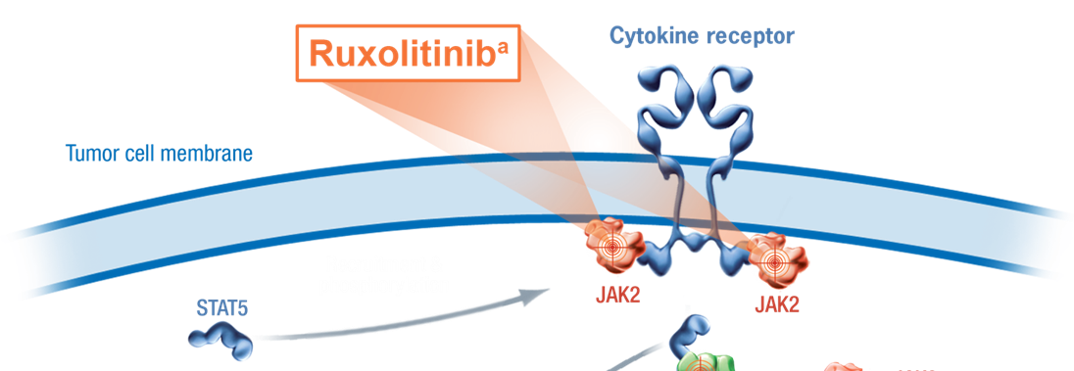

Rationale for Combination Therapy
ªRuxolitinib is a JAK1/JAK2 inhibitor
^{b}Panobinostat is a pan-DACi
Kiladjian JJ, et al. Blood. 2014;124: Abstract 711.
Notes:
Targeting multiple components of the JAK/STAT pathway, as well as parallel signaling pathways that may also be involved in the pathogenesis of MF, has the potential to have a synergistic therapeutic effect on the underlying disease
Although dysregulation of the JAK/STAT pathway is considered a hallmark of myelofibrosis, other less active pathways may exist, and their inhibition may complement inhibition of the JAK/STAT pathway, culminating in more pronounced treatment benefits
Additional modulation of upstream or downstream signaling of the JAK/STAT pathway is hypothesized to improve upon the clinical results of ruxolitinib and have a positive impact on the underlying disease

Slide 4
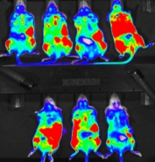
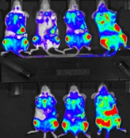
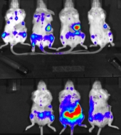
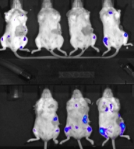
Combination Therapy in a JAK2 Mutation-Driven Ba/F3 Murine Model
x 10⁶
10
Ruxolitinib 60 mg/kg
Panobinostat 12 mg/kg
Rux 60 mg/kg +
Pan 12 mg/kg
Vehicle
8
Bioluminescence
6
4
100%
40% *
11% *
3% *† ‡
2
% of control (on day 11)
*P < .05 vs. vehicle control; † P < .05 vs. ruxolitinib; ‡ P < .05 vs panobinostat at same dose
Evrot E, et al. Clin Cancer Res. 2013;19(22):6230-6241.
Kiladjian JJ, et al. Blood. 2014;124: Abstract 711.

Slide 5
Study Design
Phase Ib, open-label, multicenter, dose-finding study (NCT01433445)
Dose-escalation phase
Safety-expansion phase
PMF or PPV/PET‑MF
≥1 IPSS risk factor¹
Palpable spleen ≥ 5 cm
Determine MTD/RP2D (n = 9, minimum)
Enroll cohorts until MTD and/or RP2D reached
23 additional patients at RP2D
2 x 28-day cycles
Confirm RP2D
Dose Level | Combination treatment dose
 | Ruxolitinib | Panobinostat
1 | 5 mg BID | 10 mg TIW/QOW
2 | 10 mg BID | 10 mg TIW/QOW
3 | 15 mg BID | 10 mg TIW/QOW
4 | 15 mg BID | 15 mg TIW/QOW
5 | 15 mg BID | 20 mg TIW/QOW
6 (RP2D) | 15 mg BID | 25 mg TIW/QOW
10 sites across 5 countries (France, Germany, Ireland, Italy, and UK)
Data cutoff, 29 Aug 2014 (Start date, Nov 2011; projected completion date, Jan 2016)
Cervantes F, et al. Blood. 2009;113(13):2895-2901.
BID, twice daily; TIW, three times a week; QOW, every other week.
Kiladjian JJ, et al. Blood. 2014;124: Abstract 711.
Notes:
5
The study included a dose-escalation phase with a primary objective of determining a maximum tolerated dose (MTD) and/or a potential phase II dose (RP2D)
Secondary objectives included evaluating the safety of oral co-administration of ruxolitinib and panobinostat and characterizing the pharmacokinetics (PK) of ruxolitinib and panobinostat at varying doses
Following the determination of the MTD and/or potential RP2D in the escalation phase, a dose-expansion phase was conducted to further define the safety and tolerability of the combination treatment and confirm the RP2D
An additional 23 patients were enrolled in the expansion phase
A total of 34 patients were treated at the potential RP2D
Additional inclusion criteria were
At least 1 of the following risk factors:
Presence of constitutional symptoms (eg, weight loss, fever, night sweats)
Marked anemia (hemoglobin < 10 g/dL)
Leukocytosis (white blood cell count > 25 × 10⁹/L)
Circulating blasts ≥ 1%

Slide 6
Assessments
The primary outcome measure was the rate of dose-limiting toxicities at the different dose levels
Efficacy was assessed on the basis of:
≥50% reduction in spleen length by palpation compared with baseline
≥35% reduction in spleen volume as assessed by magnetic resonance imaging/computed tomography compared with baseline (expansion phase only)
Changes in bone marrow (BM) fibrosis grade, as assessed by BM biopsies
Changes in JAK2 V617F allele burden, BM fibrosis, and cytokines were measured in the expansion phase
Kiladjian JJ, et al. Blood. 2014;124: Abstract 711.

Slide 7
Baseline Patient Characteristics
n, (%) | Escalation phase (n = 38) | Expansion phase (n = 23) | Patients treated at RP2D (n = 34)
Age, median (range), years | 63 (47-79) | 67 (54-77) | 65 (53-77)
Male Female | 19 (50) 19 (50) | 16 (69.6) 7 (30.4) | 20 (58.8) 14 (41.2)
MF classification PMF PPV-MF PET-MF | 17 (44.7) 10 (26.3) 11 (28.9) | 10 (43.5) 6 (26.1) 7 (30.4) | 14 (41.2) 11 (32.4) 9 (26.5)
Time since initial MF diagnosis, median (range), months | 19.8 (1.8-189.2) | 23.7 (0.6-245.0) | 22.4 (0.6-245.0)
Presence of constitutional symptomsª | 30 (78.9) | 19 (82.6) | 28 (82.4)
Age ˃ 65 yearsª | 14 (36.8) | 13 (56.5) | 15 (44.1)
Hemoglobin < 10 g/dLª | 13 (34.2) | 7 (30.4) | 9 (26.5)
WBC > 25 × 10⁹/Lª | 8 (21.1) | 7 (30.4) | 9 (26.5)
Circulating blasts ≥ 1%ª | 17 (44.7) | 9 (39.1) | 19 (55.9)
Prior PRBC transfusion | 17 (44.7) | 3 (13.0) | 7 (20.6)
Median (range) baseline spleen length, cm | 13 (5-35) | 12 (5-24) | 12 (5-24)
ª At study entry
One patient in cohort 2 of the escalation phase received prior splenic irradiation
Kiladjian JJ, et al. Blood. 2014;124: Abstract 711.
Notes:
7

Slide 8
Patient Disposition
n (%) | Escalation phase (n = 38) | Expansion phase (n = 23) | Patients treated at RP2D (n = 34)
Patient treated Ongoing Discontinued | 18 (47.4) 20 (52.6) | 18 (78.3) 5 (21.7) | 26 (76.5) 8 (23.5)
Primary reason discontinuation Adverse event Withdrawal of consent Death Disease progression Protocol deviationª | 9 (23.7) 1 (2.6) 2 (5.3) 7 (18.4) 1 (2.6) | 3 (13.0) 1 (4.3) 0 1 (4.3) 0 | 5 (14.7) 1 (2.9) 0 1 (2.9) 1 (2.9)
ª Treatment interruption ˃4 weeks due to grade 3/4 thrombocytopenia
Kiladjian JJ, et al. Blood. 2014;124: Abstract 711.
Notes:
8

Slide 9
Exposure to Study Medication
Duration of exposure
Median (range) | Escalation Phase (n = 38) | Expansion Phase (n = 23) | Patients Treated at RP2D (n = 34)
Panobinostat | 82.6 weeks (2.6-144.6) | 42.4 weeks (2.6-72.3) | 51.1 weeks (2.6-97.6)
Ruxolitinib | 83.7 weeks (3.4-144.9) | 43.7 weeks (3.1-75.7) | 52.9 weeks (3.1-101.0)
Patients with ≥1 dose interruption/change
n (%) | Escalation Phase (n = 38) | Expansion Phase (n = 23) | Patients Treated at RP2D (n = 34)
Panobinostat | 24 (63.2) | 12 (52.2) | 22 (64.7)
Ruxolitinib | 29 (76.3) | 11 (47.8) | 20 (58.8)
Kiladjian JJ, et al. Blood. 2014;124: Abstract 711.
Notes:
9

Slide 10
Summary of Safety in the Escalation Phase
The most common adverse events (> 30%) of any grade in the escalation phase were diarrhea (65.8%), anemia (63.2%), thrombocytopenia (52.6%), muscle spasms (36.8%), asthenia (36.8%), headache (34.2%), and nausea (31.6%)
Anemia (42.1%) and thrombocytopenia (21.1%) were the most common grade 3/4 adverse events; 2 patients discontinued due to each AE
There were 2 deaths within 30 days of last treatment:
1 due to myocardial infarction (ruxolitinib 15 mg BID, panobinostat 15 mg TIW, QOW)
1 due to progression of MF (ruxolitinib 15 mg BID, panobinostat 20 mg TIW, QOW)
Both were assessed by the treating investigator as not suspected to be treatment related
No MTD was reached
DLTs included:
Thrombocytopenia, grade 4, in cohort 2 (n =1) and cohort 5 (n =1)
Nausea, grade 3, in cohort 6 (n = 1)
RP2D: Panobinostat, 25 mg TIW, QOW + ruxolitinib 15 mg BID
Kiladjian JJ, et al. Blood. 2014;124: Abstract 711.
Notes:
One patient died 14 days after the last dose due to disease progression and the other patient died 1 day after last dose due to MI.

Slide 11
Hematologic Adverse Events
The most common hematologic AEs were anemia and thrombocytopenia
n (%)ª | Expansion Phase n = 23 |  | Patients Treated at the RP2D n = 34
 | All grade | Grade 3/4 | All grade | Grade 3/4
Anemia | 18 (78.3) | 8 (34.8) | 26 (76.5) | 11 (32.4)
Thrombocytopenia | 11 (47.8) | 7 (30.4) | 16 (47.1) | 9 (26.5)
Neutropenia | 1 (4.3) | 1 (4.3) | 3 (8.8) | 2 (5.9)
Platelet count decreased | 1 (4.3) | 0 | 2 (5.9) | 0
Leukopenia | 1 (4.3) | 1 (4.3) | 2 (5.9) | 1 (2.9)
ªIn ≥ 5% of patients treated at the RP2D; regardless of relationship to study treatment at any time during or up to 30 days after last dose.
Among patients treated at the RP2D, 1 patient (expansion phase) discontinued due to anemia and 1 (escalation phase) due to thrombocytopenia^{b}
^{b}Patient had an interruption in study treatment for >4 weeks due to grade 3/4 thrombocytopenia and therefore was discontinued.
Kiladjian JJ, et al. Blood. 2014;124: Abstract 711.

Slide 12
Hemoglobin and Platelet Levels Over Time
Hemoglobin levels (patients treated at RP2D)
130
120
110
Mean Hemoglobin Level ± SD (g/L)
100
90
80
Baseline
4
8
12
16
20
24
28
Week
Platelet levels (patients treated at RP2D)
400
300
200
Mean Platelet Count ± SD (x 10⁹/L)
100
0
Baseline
4
8
12
16
20
24
28
Kiladjian JJ, et al. Blood. 2014;124: Abstract 711.
Week

Slide 13
Nonhematologic Adverse Events (>20%)
 | Expansion Phase n = 23 |  | Patients Treated at the RP2D n = 34
n (%)ª | All grade | Grade 3/4 | All grade | Grade 3/4
Any AE | 23 (100) | 15 (65) | 34 (100) | 22 (65)
Diarrhea | 14 (61) | 3 (13) | 23 (68) | 5 (15)
Asthenia | 10 (44) | 1 (4) | 15 (44) | 3 (9)
Muscle spasms | 7 (30) | 0 | 12 (35) | 0
Vomiting | 6 (26) | 0 | 12 (35) | 1 (3)
Nausea | 7 (30) | 0 | 11 (32) | 2 (6)
Fatigue | 6 (26) | 0 | 10 (29) | 3 (9)
Headache | 5 (22) | 0 | 10 (29) | 0
Dyspnea | 5 (22) | 0 | 10 (29) | 2 (6)
Abdominal pain | 5 (22) | 0 | 8 (24) | 1 (3)
Peripheral edema | 4 (17) | 0 | 7 (21) | 0
Constipation | 4 (17) | 0 | 7 (21) | 0
Dizziness | 3 (13) | 0 | 7 (21) | 0
ªIn ≥ 20% of patients treated at the RP2D; regardless of relationship to study treatment at any time during or up to 30 days after last dose
Kiladjian JJ, et al. Blood. 2014;124: Abstract 711.

Slide 14
Change in Spleen Length: Escalation Phase
Baseline Spleen Length (cm)
29
21
21
20
20
15
15
14
14
13
13
12.5
12
12
12
10.5
10
7.5
6
5
5
5
5
13
19
11.5
16
18
11
15
16
21
13
21
17.5
35
13
13
Maximum Change From Baseline in Spleen Length by Palpation, %
50% decrease
Ruxolitinib / Panobinostat
5 mg BID / 10 TIW QOW
10 mg BID / 10 TIW QOW
15 mg BID / 10 TIW QOW
15 mg BID / 15 TIW QOW
(Nonpalpable)
15 mg BID / 20 TIW QOW
15 mg BID / 25 TIW QOW
81.6% (31/38) of patients in the escalation phase achieved a ≥ 50% reduction in palpable spleen length at any time during the study
22 patients (57.9%) achieved a 100% reduction in spleen length (nonpalpable spleen)
Kiladjian JJ, et al. Blood. 2014;124: Abstract 711.

Slide 15
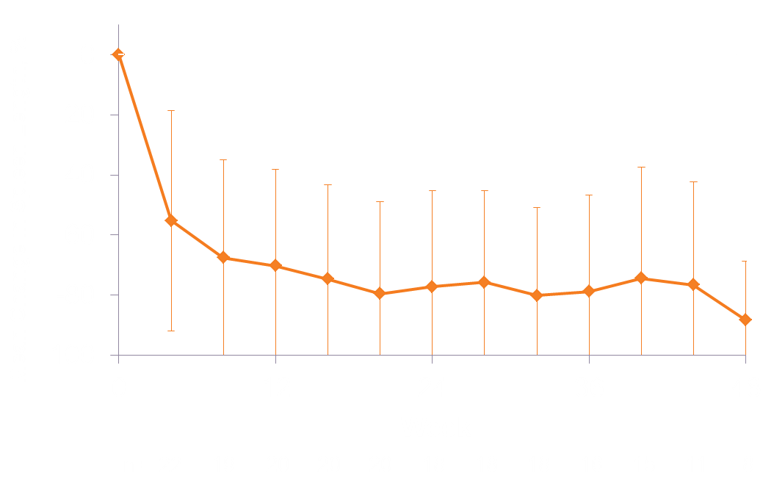
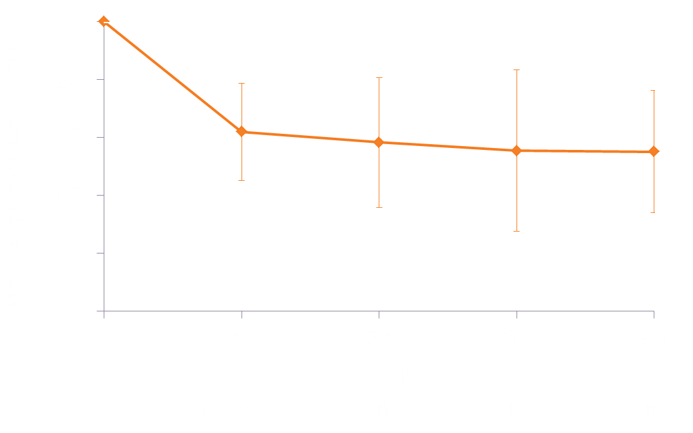
Change in Spleen Size Over Time: Expansion Phase
Spleen Length
Spleen Volume
Best spleen size reduction at any time:
Mean, -78.7% (SD, 29.36%)
Median, -100% (range, 0% to -100%)
Mean, -48.3% (SD, 21.61%)
Median, -46.7% (range, -8.7% to -84.4%)
-100% = nonpalpable
Kiladjian JJ, et al. Blood. 2014;124: Abstract 711.

Slide 16
Change in Spleen Volume: Expansion Phase
Baseline Spleen Length (cm)
12
7
8
6
10
7
6
24
5
5
5
9
13
18
18
17
13.5
10
19
12
13
14
15
No
change
Best Decrease From Baseline in Spleen Length by Week 24, %
50% decrease
Ruxolitinib / panobinostat
15 mg BID / 25 TIW QOW
Nonpalpable
78.3% (18/23) of patients achieved a ≥ 50% reduction in palpable spleen length on or before week 24 (C7D1)
12 patients (52.2%) achieved a 100% reduction in spleen length (nonpalpable spleen)
In COMFORT-II, 62% (91/146) of patients achieved a ≥50% reduction in palpable spleen length by week 24
Kiladjian JJ, et al. Blood. 2014;124: Abstract 711.

Slide 17
Change in Spleen Volume: Expansion Phase
Baseline Spleen Volume (cm³)
973
1407
2367
2133
1845
1136
2983
2771
755
2885
1397
1524
2401
1211
3333
2304
3899
1098
3681
1298
650
Best Decrease in Spleen Volume by Week 24, %
35% decrease
Ruxolitinib / panobinostat
15 mg BID / 25 TIW QOW
65% of patients (15/23) in the expansion phase achieved a ≥35% reduction from baseline in spleen volume on or before week 24 (C7D1)
2 patients did not have postbaseline spleen volume assessments
Kiladjian JJ, et al. Blood. 2014;124: Abstract 711.

Slide 18
JAK2 V617F Allele Burden
17 of 22 patients were JAK2 V617F-positive at baseline
21 of 22 patients were ruxolitinib naive
5/17 patients (29%) had a ≥ 20% decrease from baseline in allele burden
This decrease tended to occur at the 12 week assessment
The prior ruxolitinib-treated patient had a 44% decrease from baseline
ªExpansion phase; only patients with ≥2 on treatment assessments were included
Kiladjian JJ, et al. Blood. 2014;124: Abstract 711.

Slide 19
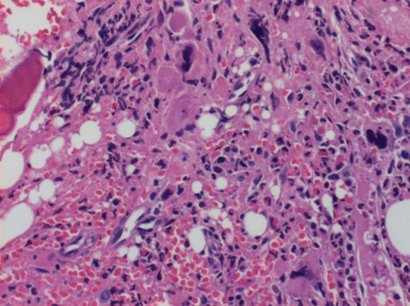
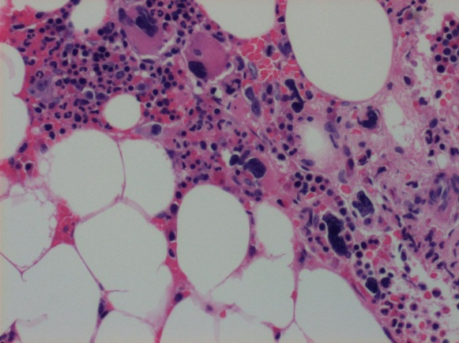
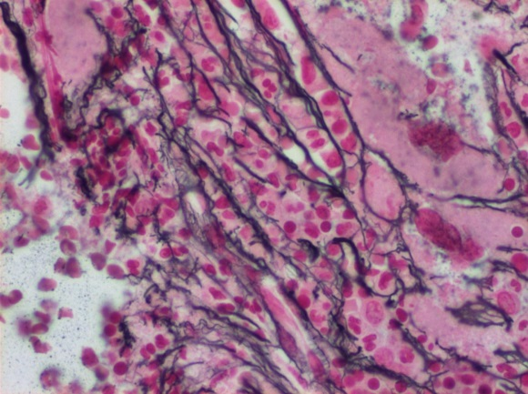
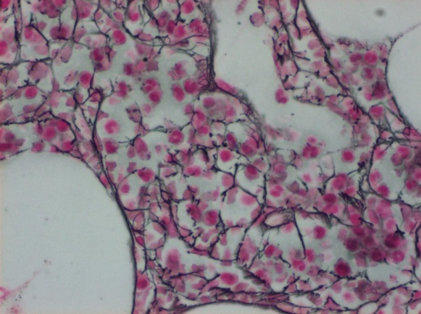
Bone Marrow Fibrosis (Central Review)
3 patients had improved fibrosis (MF3 → 2, 2 → 1, 1 → 0)
10 patients had stable fibrosis grading (no change)
2 patients worsened (MF1 → 2)
MF3 → 2
Baseline
C13D1
H&E
Reticulin
Kiladjian JJ, et al. Blood. 2014;124: Abstract 711.
Notes:
MF 3 to 2, pt 400_00011
MF 2 to 1, pt 400_00013
MF 1 to 0, pt 100_00005

Slide 20
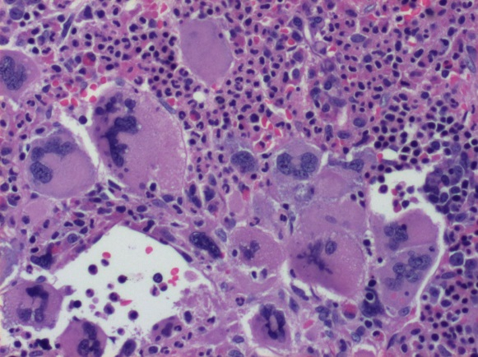
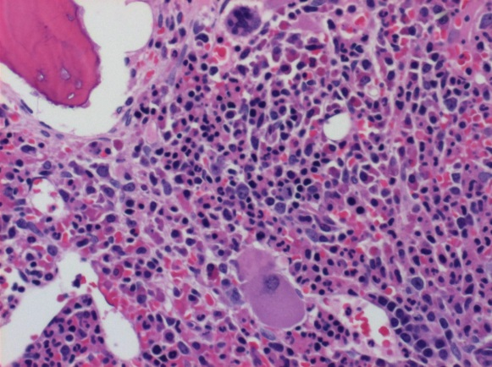
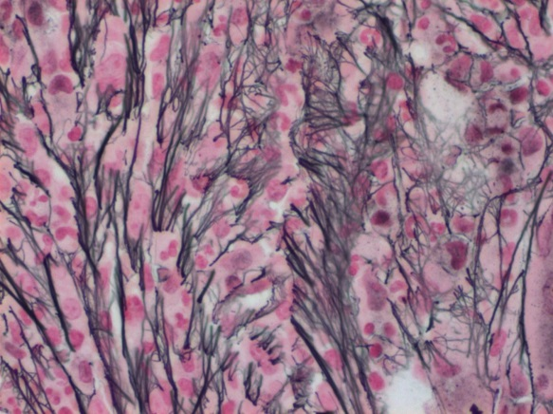
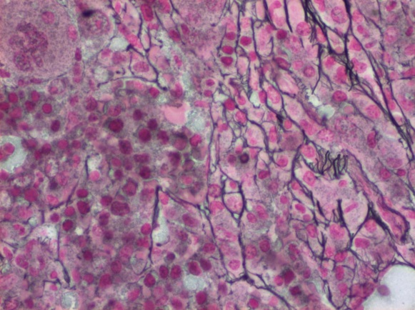
Bone Marrow Fibrosis (Central Review)
3 patients had improved fibrosis (MF3 → 2, 2 → 1, 1 → 0)
10 patients had stable fibrosis grading (no change)
2 patients worsened (MF1 → 2)
MF2 → 1
Baseline
C13D1
H&E
Reticulin
Kiladjian JJ, et al. Blood. 2014;124: Abstract 711.
Notes:
MF 3 to 2, pt 400_00011
MF 2 to 1, pt 400_00013
MF 1 to 0, pt 100_00005

Slide 21
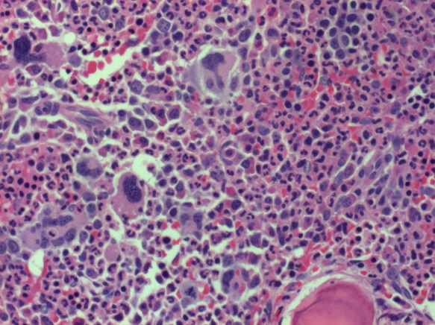
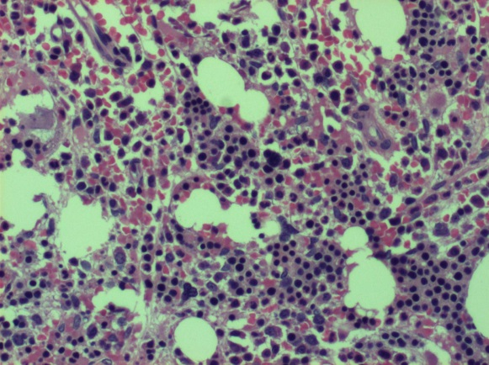
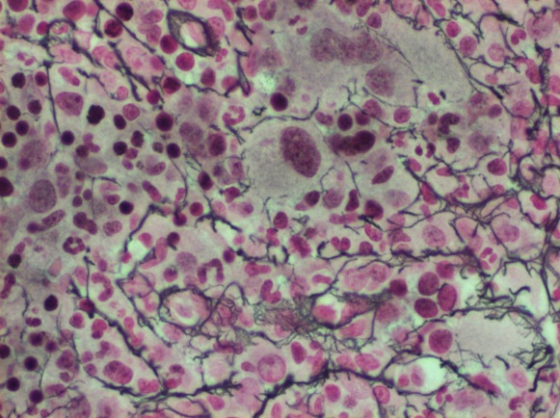
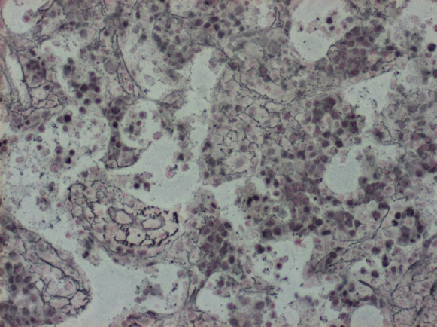
Bone Marrow Fibrosis (Central Review)
3 patients had improved fibrosis (MF3 → 2, 2 → 1, 1 → 0)
10 patients had stable fibrosis grading (no change)
2 patients worsened (MF1 → 2)
MF1 → 0
Baseline
C13D1
H&E
Reticulin
Kiladjian JJ, et al. Blood. 2014;124: Abstract 711.
Notes:
MF 3 to 2, pt 400_00011
MF 2 to 1, pt 400_00013
MF 1 to 0, pt 100_00005

Slide 22
Change in Cytokine Levels
Three different cytokines with median baseline levels in the abnormal rangeª normalized on treatment
IL-18 is a pro-inflammatory cytokine
IL-18 levels were also downregulated at 4 weeks in another JAK2i MF study¹
Myeloperoxidase (MPO) and matrix metalloproteinase 9 (MMP9) are both markers of inflammatory disease activity^{2,3}
IL-18
MMP9
MPO
Fold-Change From Baseline (+/- 1 SE interval)
Leptin
Leptin levels increased on treatment; this effect was also seen in COMFORT-II, where increases were associated with improvement in weight loss⁴
Leptin was also up-regulated at 4 weeks in the SAR302503 study¹
Fold-Change From Baseline (+/- 1 SE interval)
Method: MRBM HumanMAP® V2.0
ªReference ranges based on MRBM data of ~100 healthy individuals and are for research use only.
Talpaz M, et al. J Clin Oncol. 2013;31(Suppl): Abstract 7110.
Anatoliotakis N, et al. Curr Top Med Chem. 2013;13(2):115-138.
Biasi F, et al. PLoS One. 2012;7(7):e41839.
Squires M, et al. Blood. 2013;122(21): Abstract 2070.
Kiladjian JJ, et al. Blood. 2014;124: Abstract 711.
Notes:
Fold change at week 48
Ferritin, 18.24 fold increase
Leptin, 4.09 fold increase
IL-8, 1.54-fold increase
IL-18, 0.64 fold-decrease
Matrix metalloproteinase 9, 0.36 fold decrease
Myeloperoxidase, 0.32-fold decrease

Slide 23
Conclusions
The combination of ruxolitinib 15 mg BID and panobinostat 25 mg TIW QOW was well tolerated and resulted in substantial reductions in splenomegaly
Most patients treated at the RP2D of combination therapy achieved a spleen response
Combination treatment at the RP2D had an acceptable safety profile
The rates of AEs observed in this trial are in line with the expected and known AEs of these two agents when used as monotherapies¹⁻⁵
For some patients, the combination of ruxolitinib and panobinostat resulted in decreases in JAK2 V617F allele burden and bone marrow fibrosis
In summary, the combination of panobinostat and ruxolitinib in MF is associated with favorable treatment benefits and encourages further exploration
Verstovsek S, et al. N Engl J Med. 2012;366:799-807.
Harrison C, et al. N Engl J Med. 2012;366:787-798.
DeAngelo DJ. Leukemia. 2013;27:1628-1636.
DeAngelo DJ. Br J Haematol. 2013;162: 326-335.
Mascarenhas J. Br J Haematol. 2013;161: 68-75.
Kiladjian JJ, et al. Blood. 2014;124: Abstract 711.

Slide 24
Hematologic Adverse Events
The most common hematologic AEs were anemia and thrombocytopenia
n (%)ª | Escalation phase n = 38 |  | Expansion phase n = 23 |  | Patients treated at the RP2D n = 34
 | All grade | Grade 3/4 | All grade | Grade 3/4 | All grade | Grade 3/4
Anemia | 24 (63.2) | 16 (42.1) | 18 (78.3) | 8 (34.8) | 26 (76.5) | 11 (32.4)
Thrombocytopenia | 20 (52.6) | 8 (21.1) | 11 (47.8) | 7 (30.4) | 16 (47.1) | 9 (26.5)
Neutropenia | 3 (7.9) | 2 (5.3) | 1 (4.3) | 1 (4.3) | 3 (8.8) | 2 (5.9)
ªRegardless of relationship to study treatment at any time during or up to 30 days after last dose.
In the escalation phase, 2 patients discontinued due to anemia and 2 discontinued due to thrombocytopenia
Among patients treated at the RP2D, 1 patient (expansion phase) discontinued due to anemia and 1 (escalation phase) due to thrombocytopeniaª
ªPatient had an interruption in study treatment for > 4 weeks due to grade 3/4 thrombocytopenia and therefore was discontinued.
Kiladjian JJ, et al. Blood. 2014;124: Abstract 711.

Slide 25
Nonhematologic Adverse Events (> 20%)
 | Escalation phase n = 38 |  | Expansion phase n = 23 |  | Patients treated at the RP2D n = 34
%ª | All grade | Grade 3/4 | All grade | Grade 3/4 | All grade | Grade 3/4
Any AE | 100 | 71 | 100 | 65 | 100 | 65
Diarrhea | 66 | 8 | 61 | 13 | 68 | 15
Asthenia | 37 | 5 | 44 | 4 | 44 | 9
Muscle spasms | 37 | 0 | 30 | 0 | 35 | 0
Headache | 34 | 0 | 22 | 0 | 29 | 0
Nausea | 32 | 8 | 30 | 0 | 32 | 6
Abdominal pain | 29 | 8 | 22 | 0 | 24 | 3
Peripheral edema | 29 | 0 | 17 | 0 | 21 | 0
Vomiting | 26 | 3 | 26 | 0 | 35 | 3
Dyspnea | 26 | 5 | 22 | 0 | 29 | 6
Creatinine increased | 26 | 0 | 9 | 0 | 15 | 0
Dizziness | 24 | 0 | 13 | 0 | 21 | 0
Fatigue | 21 | 8 | 26 | 0 | 29 | 9
Pruritus | 21 | 0 | 17 | 0 | 15 | 0
Pain in extremity | 21 | 0 | 13 | 0 | 18 | 0
Pyrexia | 21 | 0 | 13 | 4 | 15 | 3
Cough | 16 | 0 | 22 | 0 | 18 | 0
Nasopharyngitis | 11 | 0 | 22 | 0 | 15 | 0
Constipation | 11 | 0 | 17 | 0 | 21 | 0
ª Regardless of relationship to study treatment at any time during or up to 30 days after last dose.
Kiladjian JJ, et al. Blood. 2014;124: Abstract 711.

Slide 26
Nonhematologic Adverse Events (>20%)
 | Expansion phase n = 23 |  | Patients treated at the RP2D n = 34
%ª | All grade | Grade 3/4 | All grade | Grade 3/4
Any AE | 100 | 65 | 100 | 65
Diarrhea | 61 | 13 | 68 | 15
Asthenia | 44 | 4 | 44 | 9
Muscle spasms | 30 | 0 | 35 | 0
Vomiting | 26 | 0 | 35 | 3
Nausea | 30 | 0 | 32 | 6
Fatigue | 26 | 0 | 29 | 9
Headache | 22 | 0 | 29 | 0
Dyspnea | 22 | 0 | 29 | 6
Abdominal pain | 22 | 0 | 24 | 3
Peripheral edema | 17 | 0 | 21 | 0
Constipation | 17 | 0 | 21 | 0
Dizziness | 13 | 0 | 21 | 0
ª In ≥ 20% of patients treated at the RP2D; regardless of relationship to study treatment at any time during or up to 30 days after last dose.
Kiladjian JJ, et al. Blood. 2014;124: Abstract 711.

